Slide 1
Informed/Heuristic search and Exploration
Fundamentals of Artificial Intelligence
Slides are mostly adapted from AIMA, MIT Open Courseware,
Svetlana Lazebnik (UIUC), Manuela Veloso (CMU)
Spring 2008

Slide 2
Review: Tree search
Initialize the frontier using the starting state
While the frontier is not empty
  Choose a frontier node to expand according to search strategy and take it off the frontier
  If the node contains the goal state, return solution
  Else expand the node and add its children to the frontier
To handle repeated states:
  Keep an explored set; add each node to the explored set every time you expand it
  Every time you add a node to the frontier, check whether it already exists in the frontier with a higher path cost, and if yes, replace that node with the new one
Notes:
Uninformed search strategies systematically generate new states by expanding the states in the frontier, and testing them against the goal.

Slide 3

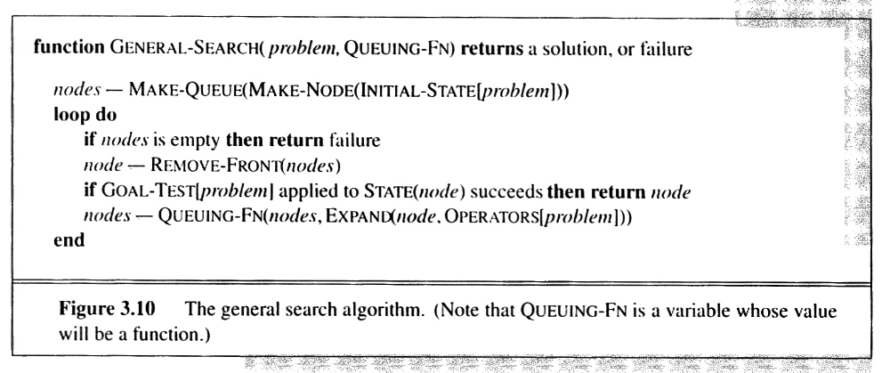
General Search revisited
EXPAND: A function to generate the successors of a node
QUEUING-FN: A function to order nodes in the queue
Notes:
We can define a general search strategy which has a expand function to generate the successors of a node
And a queuing function to order the nodes in the queue

Slide 4
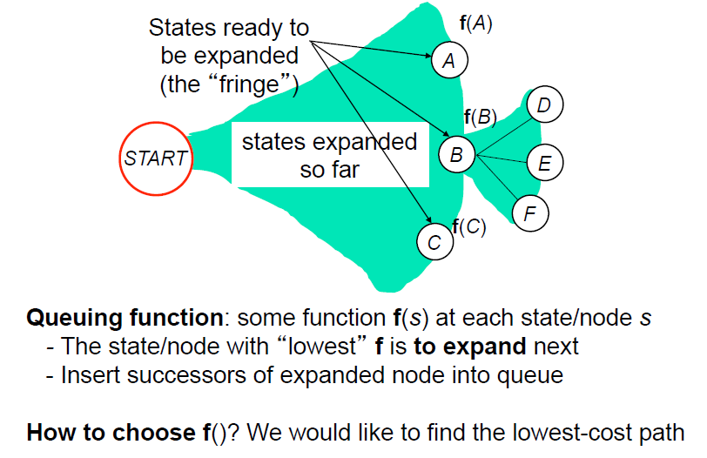
General Search
Notes:
The only place that we can apply any knowledge is the queuing function which determines the node to expand next
The best search strategy would expand the state with the lowest cost.
The question here is how to choose the lowest cost path
We need an evaluation function f that can help us to determine the cost

Slide 5
Review: Uninformed search strategies
A search strategy is defined by picking the order of node expansion
Uninformed search strategies use only the information available in the problem definition
only considers “already visited” path
without edge cost, guided by
  path length as number of nodes
  successor relationships and structure (leftmost,…)
with edge cost, guided by
  path length as cost of visited path
Notes:
Uninformed search strategies only considers the already visited path.
If all edges have equal costs, the path length is defined by the number of nodes on the path
When the edge costs vary, the total cost is the sum of all paths along the visited states

Slide 6
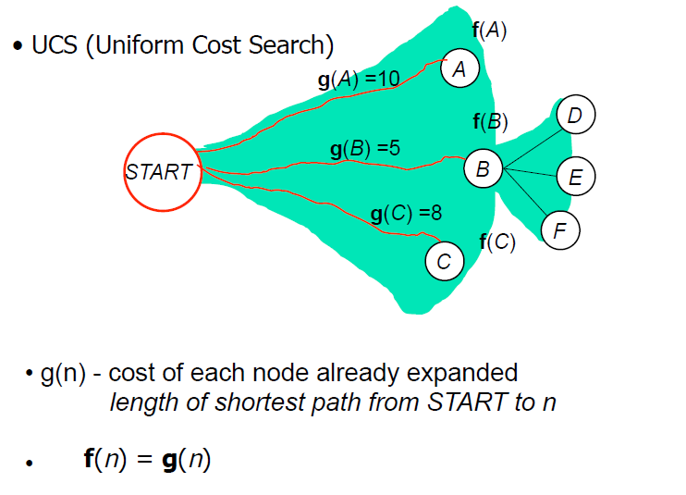
Uniform Cost Search
Notes:
Therefore the evaluation function f in general search strategy is equal to the cost of shortest path from the start state to the state n, which we denoted as g(n)

Slide 7
Informed search strategies
Informed search strategies use problem specific knowledge beyond the definition of the problem itself
Idea: give the algorithm “hints” about the desirability of different states
  Use an evaluation function to rank nodes and select the most promising one for expansion
Greedy best-first search
A* search
Notes:
In the informed search strategies, we use additional , problem specific knowledge besides the problem definition.
This knowledge gives us hints about the desirability of expanding a state.

Slide 8
Best-first search
Idea: use an evaluation function f(n) to select the node for expansion
  estimate of "desirability"
  Expand most desirable unexpanded node
Implementation:
Order the nodes in fringe in decreasing order of desirability
Spring 2008
Notes:
When the nodes are ordered so that the one with the best evaluation function -that is the most desirable one- is expanded first, the resulting strategy is called as best first search
However, we can only choose a node, which APPEARS to be the best, since we do not have the full knowledge. Otherwise, we would not need any search at all.

Slide 9
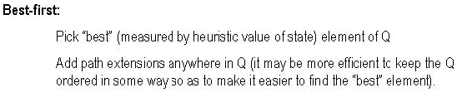
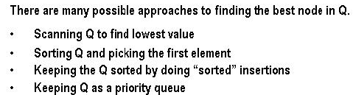
Best-first search
Spring 2008
Notes:
When we have the evaluation function based on desirability we can implement best first search in several ways.
Since we want to pick the best from the Q, we can either sort the queue, or prefer to search for the lowest value.
Usually we will prefer to keep the Q as a priority queue

Slide 10
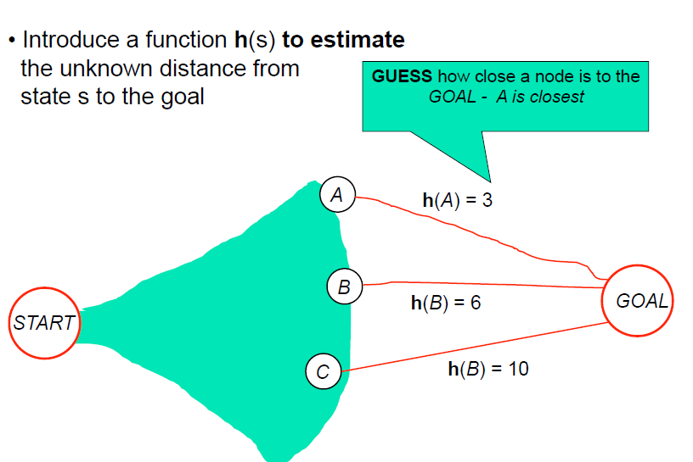
Informed – Estimate cost to the goal
Notes:
A key component in best-first algorithms is a heuristic function, h(n), which is the estimated cost of the cheapest path from n to a goal node

Slide 11
Heuristic Function
Heuristic – several meanings
- To find, or discover (Heureka, Archimedes)
- Computers, Mathematics. pertaining to a trial-and-error
method of problem solving used when an algorithmic
approach is impractical.
h cannot be computed solely from the states and transitions in the current problem -> If we could, we would already know the optimal path!
h(.) is based on external knowledge about the problem -> informed search

Slide 12
Greedy best-first search
Greedy best-first search expands the node that appears to be closest to goal
Evaluation function f(n) = h(n) (heuristic)
= estimate of cost from n to goal
e.g., h_{SLD}(n) = straight-line distance from n to Bucharest
Note that, h_{SLD} cannot be computed from the problem description itself. It takes a certain amount of experience to know that it is correlated with actual road distances, and therefore it is a useful heuristic
Spring 2008
Notes:
A simple best first strategy is to minimize the estimated cost to reach the goal.
That is, the node whose state is judged to be closest to the goal is always expanded first.
H(n) = 0 for the goal state
And h for any other nodes is estimated based on experience about the problem.

Slide 13

Heuristic function
Heuristic function h(n) estimates the cost of reaching goal from node n
Example:
Start state
Goal state
Notes:
In route finding, or maze problems, heuristic can be an estimate of the distance to the goal state

Slide 14

Romania with step costs in km
    e.g. For Romania, cost of the cheapest path from Arad to
    Bucharest can be estimated via the straight line distance
Spring 2008
Notes:
The right hand side shows the straight line distances from any city to Bucharest.
We can only compute it if we know the map coordinates of Romania.
It is a useful heuristic because a road from A to B usually tends to head in more or less the right direction.

Slide 15

Greedy best-first search example
Notes:
From Arad we have 3 cities
Zerind, Sibiu and Timisoara with heuristics 374, 253 and 329 respectively
We will choose the shortest and thus Sibiu
It seems that it is a right choice since we are now closer to Bucharest

Slide 16

Greedy best-first search example
Notes:
Now, from Sibiu
We have Arad, Orades, Fagaras and Rimnicu Vilcea with estimates 366, 380, 176 and 193
We choose Fagaras

Slide 17

Greedy best-first search example

Slide 18

Greedy best-first search example
Notes:
Next, there are Sibiu and Bucharest with 253 and 0
We reached to Bucharest
Is it the shortest path from Arad?
Actually no
Because the path trough Sibiu-Rimnicu Vilcea and Pitesti is 140 + 80 + 97 + 101
While the path through Sibiu and Fagaras is 140+ 99 + 211
Which is longer

Slide 19
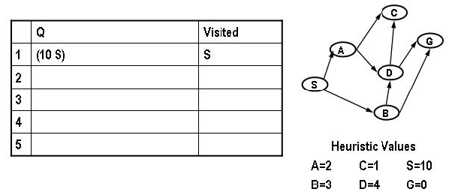

Greedy best-first search – Another example
Spring 2008
Notes:
Let’s consider another example

Slide 20
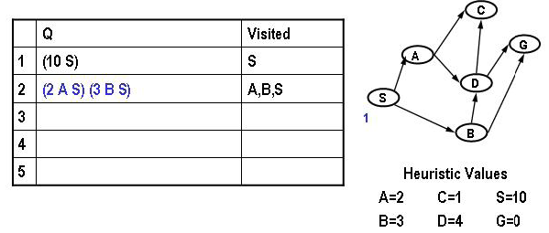
Greedy best-first search – Another example
Spring 2008
Notes:
From S there are A and b with heuristics 2 and 3, so we expand A

Slide 21
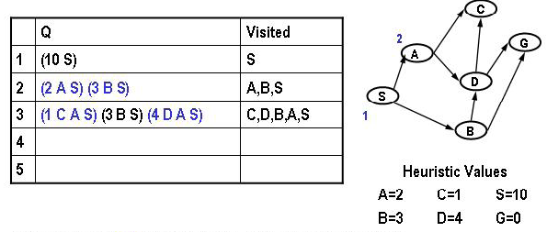
Greedy best-first search – Another example
Spring 2008

Slide 22
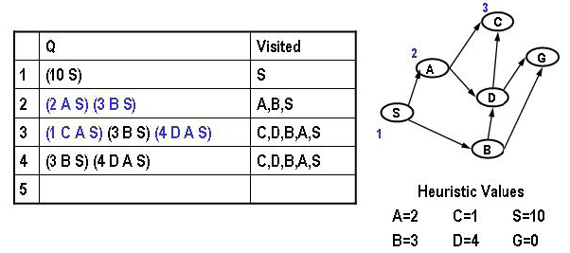
Greedy best-first search – Another example
Spring 2008
Notes:
From A we have C and S with heuristics 1 and 4
So we expand C now
It is a dead end

Slide 23
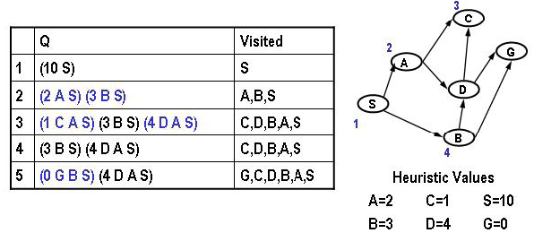
Greedy best-first search – Another example
Spring 2008
Notes:
So we expand B, with D and g with heuristics 4 and 0

Slide 24
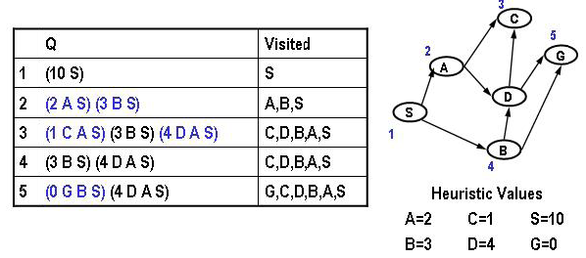
Greedy best-first search – Another example
Spring 2008
Notes:
We now expand G

Slide 25
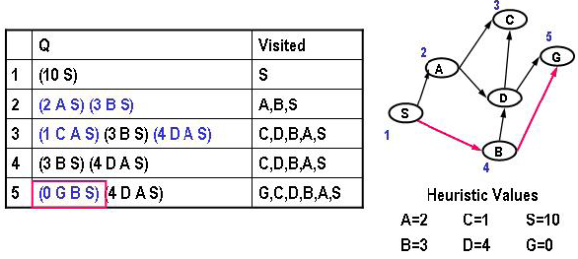
Greedy best-first search – Another example
Spring 2008
Notes:
So the path is through A B G which is in this case the shortest with path cost 2

Slide 26

Properties of greedy best-first search
Complete?
  No – can get stuck in loops
Path through Faragas is not the optimal
In getting Iasi to Faragas, it will expand Neamt first but it is a dead end
start
goal
Notes:
Let’s look at greedy best first search in more detail.
Assume that we are trying to reach Fagaras from Iasi
Straight line distance as a heuristic will expand Neamt since it is closer to Fagaras
But it is a dead end, and there is no road to Fagaras so we have to go back Iasi
If we are not keeping a repeated or visited list
Then we will go back and Forward between Iasi and Neamt in a loop and will never be able to reach Fagaras by expanding Vaslui
Therefore it is not complete

Slide 27
Properties of greedy best-first search
Complete?
  No – can get stuck in loops
Optimal?
  No
Notes:
As we have seen with the example to reach from Arad to Bucharest it may not be able to find the optimal path as well.
Therefore it is not optimal

Slide 28
Properties of greedy best-first search
Complete?
  No – can get stuck in loops
Optimal?
  No
Time?
  Worst case: O(b^{m})
  Can be much better with a good heuristic
Space?
  Worst case: O(b^{m})
  keeps all nodes in memory
Notes:
Since it has to keep all the nodes in the memory worst case space complexity is O (b^m)
Worst case time complexity is O (b^m) but can be better with a good heuristic

Slide 29
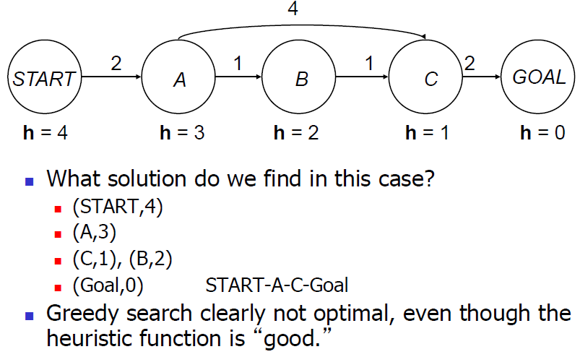
How can we fix the greedy problem?
How about keeping track of the distance already traveled in addition to the distance remaining?
Notes:
Let’s now consider a simpler example to understand what goes wrong with greedy best first search
From start state we expand A
From A there are B and C with h values 2 and 4, so we expand B
Then from B we expand C, and then from C we expand G
So, we reached to the goal state through A B and c, which is longer than the path throgh A and C
Why that happened?
Because we discarded the distance that we travelled already

Slide 30
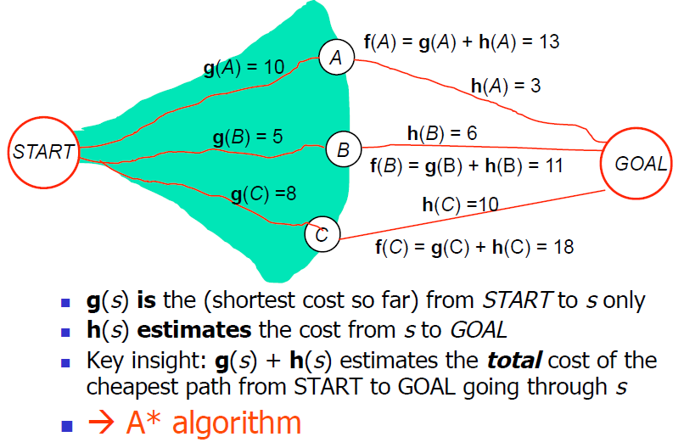
Fixing the problem
Notes:
Greedy search minimizes the estimated cost to the goal, h(n), therefore cuts the search cost considerably
However, it is neither complete nor optimal
On the other hand, uniform cost search minimizes the cost of the path so far, g(n), it is optimal and complete but may be very inefficient
It would be nice to combine the advantages of both strategies.
A* actually does this by considering the sum of both costs

Slide 31
A* search
Idea: avoid expanding paths that are already expensive
The evaluation function f(n) is the estimated total cost of the path through node n to the goal:
f(n) = g(n) + h(n)
g(n) = cost so far to reach n
h(n) = estimated cost from n to goal
Spring 2008
Notes:
Since g(n) gives the path cost from start state to a node n, and h is the estimated cost of the cheapest path from n to the goal
To find the cheapest solution, a reasonable thing is to try to find the cost f(n) which is sum of g and h
The idea is to avoid expanding paths that are already expensive.

Slide 32
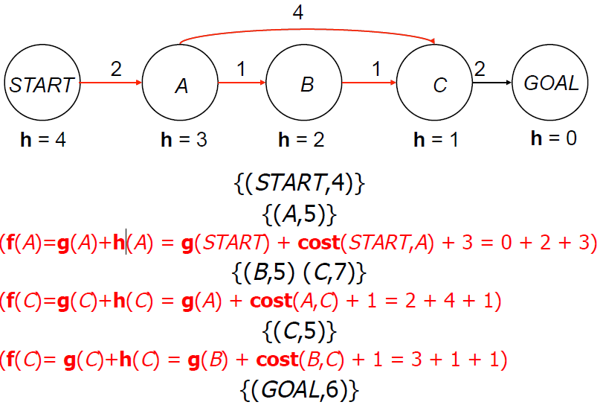
Can A* fix the problem?
Notes:
Let’s consider the previous example again
From start state we expand A with cost g + h = 2 + 3 = 5
Then we have two choices B and C
B with path cost g= 2+1 = 3 and h=2 , so f = g + h = 3+2 = 5
C with path cost g = 2 + 4 = 6 and h=1 , so f = g+h = 6=1 = 7
Unlike the previous case now we will choose B since reaching C through A is already expensive.
After b , now we will expand C with g = 2 +1 + 1 = 4 and h =1
And finally we will expand G with g = 2 + 1 + 1 + 2 = 6 and h= 0 , f = 6
So the path is now A B C G which is the shortest

Slide 33

A* search example
Notes:
If we go back to our Romania example
Now from Arad we have three options

Slide 34

A* search example
Notes:
Sibiu is 140 + 253 = 393
Timisoara is 118 + 329 = 447
Zerind is 75 + 374 + 449
We choose Sibiu

Slide 35

A* search example
Notes:
From Sibiu we have four options
Arad with g = 140 + 140 = 280 , and f = 280 + 366 = 646
Oradea with g = 140 + 151 = 291 , and f = 291 + 380 = 671
Fagaras with g = 140 + 99 = 239 and f = 239 + 176 = 415
And
Rimnicu Vilcea with g = 140 + 80 = 220 and f = 220 + 193 = 413
Now Rimnicu Vilcea is the cheapest so we continue from there

Slide 36

A* search example
Notes:
And finally we expand Pitesti and Bucharest

Slide 37

A* search example

Slide 38

A* search example
Notes:
This is the shortest path from Arad to Bucharest

Slide 39
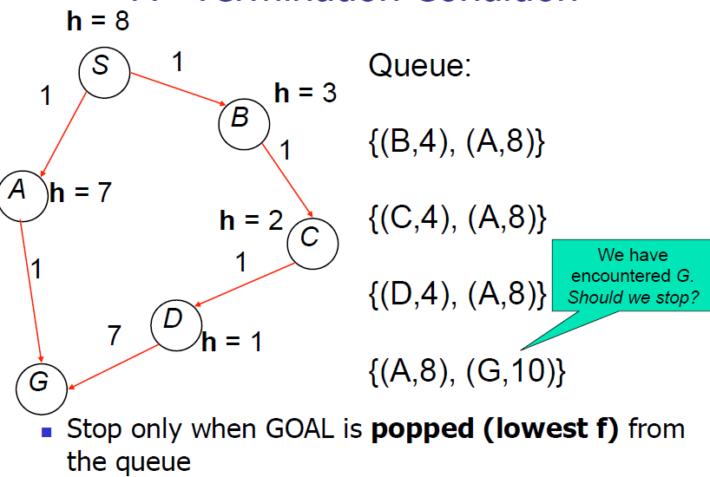
When terminate?
Notes:
Remember that in uniform cost search we were not terminating when we generate G, but when we expand it
It is the same in A*
Let’s consider an example
From S we generate A with 1+7 = 8, and B with 1 + 3 = 4
So we expand B
From B we generate C with 2 + 2 = 4
We expand C
We generate D with 3 + 1 = 4
We expand D
We generate G with 10 + 0 = 10
At this point we do stop, but rather expand A
Then we generate G again with 2 + 0 = 2
So the path is S A G which costs only 2, unlike the path A B C D G which costs 10
If we stopped when we generated G, we would find the non-optimal path

Slide 40
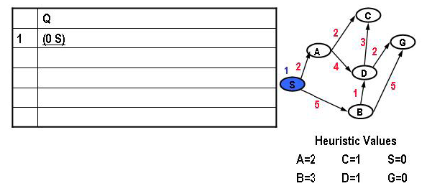

A* search – Another example
Spring 2008
Notes:
One more example
From S we have A and B with A = 2 + 2 = 4 and B = 5 + 3 = 8

Slide 41
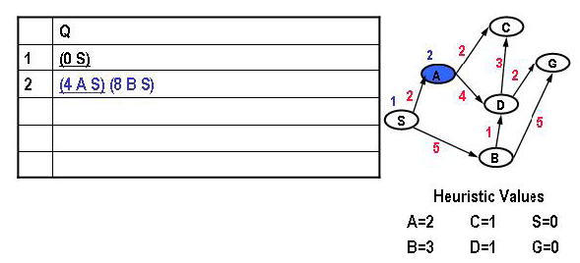
A* search – Another example
Spring 2008
Notes:
We expand A
From A we have C and D , with C = 4 + 1 = 5 and D = 6 + 1 = 7

Slide 42
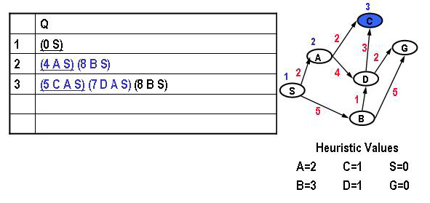
A* search – Another example
Spring 2008
Notes:
So we expand C
It is a dead end

Slide 43
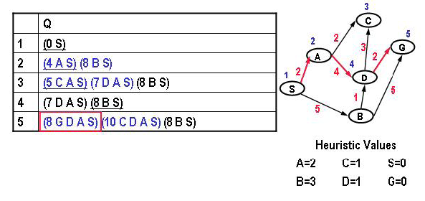
A* search – Another example
Spring 2008
Notes:
We go back to D and expand it
With G = 8 + 0 = 8
At this point we expand G

Slide 44
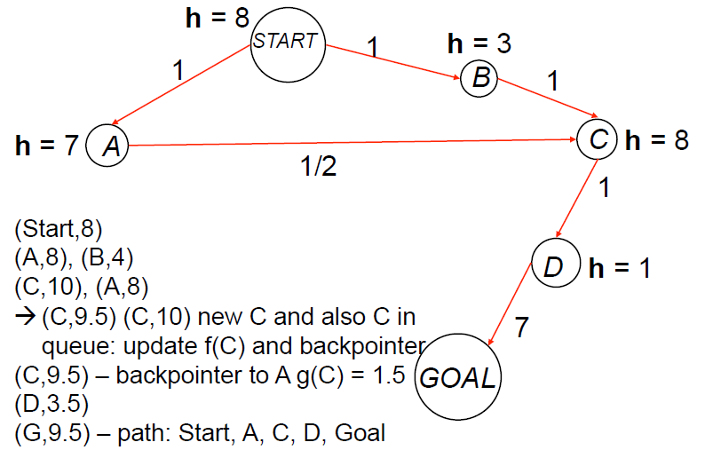
Revisiting states (in queue)
Notes:
We may have the same node twice in the queue

Slide 45
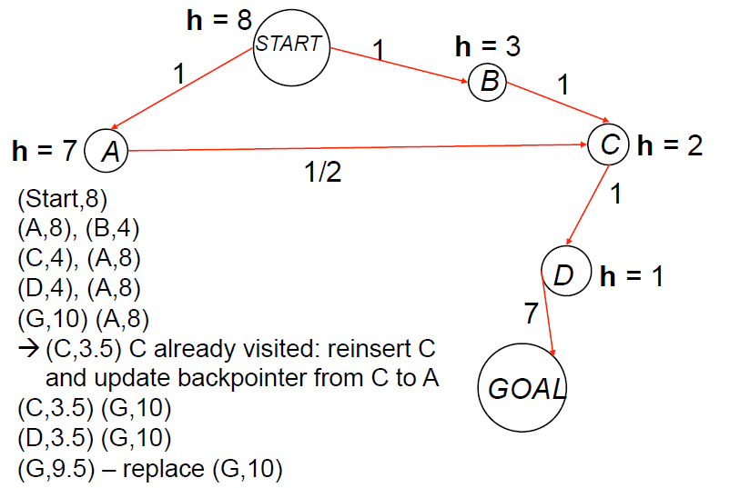
Revisiting states (already expanded)
Notes:
Or we may expand a node again

Slide 46
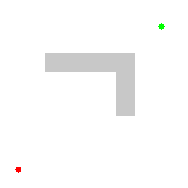
Uniform cost search vs. A* search
Source: Wikipedia
Notes:
Let’s compare A* (right) with Uniform Cost search (left)
In this case step cost is 1
So uniform cost acts like breadth first search and expands the shallowest nodes first
On the other hand A* search goes towards the goal till hits the barrier

Slide 47
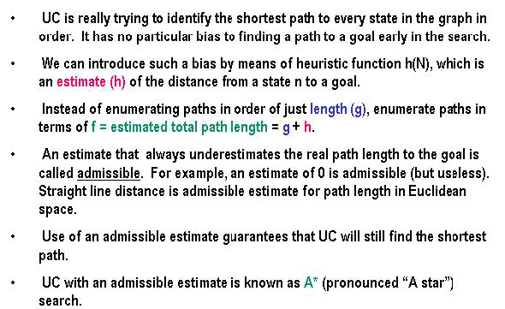
Uniform Cost (UC) versus A*
Spring 2008

Slide 48
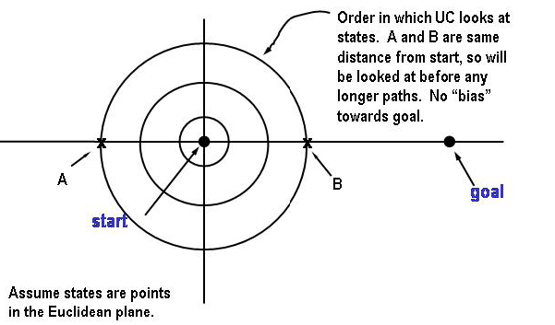
Why use estimate of goal distance
Spring 2008

Slide 49
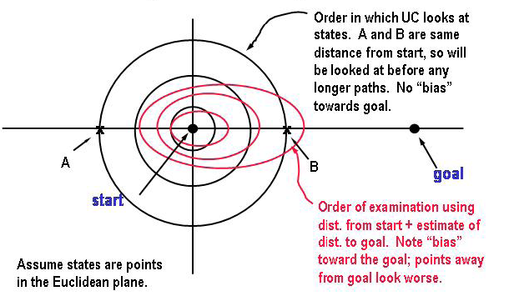
Why use estimate of goal distance
Spring 2008

Slide 50
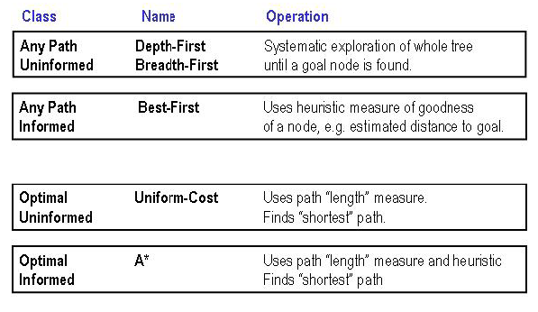
Classes of search
Spring 2008
Notes:
In the next lecture, we will analyze A*

Slide 51
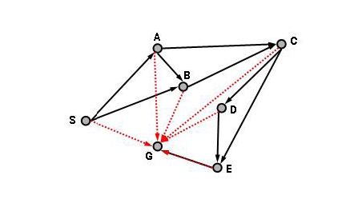
Straight line estimate
Spring 2008

